Slide 1
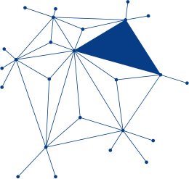
Software Privacy
&
Legal Consequences
By: Safalta Shrestha

Slide 2
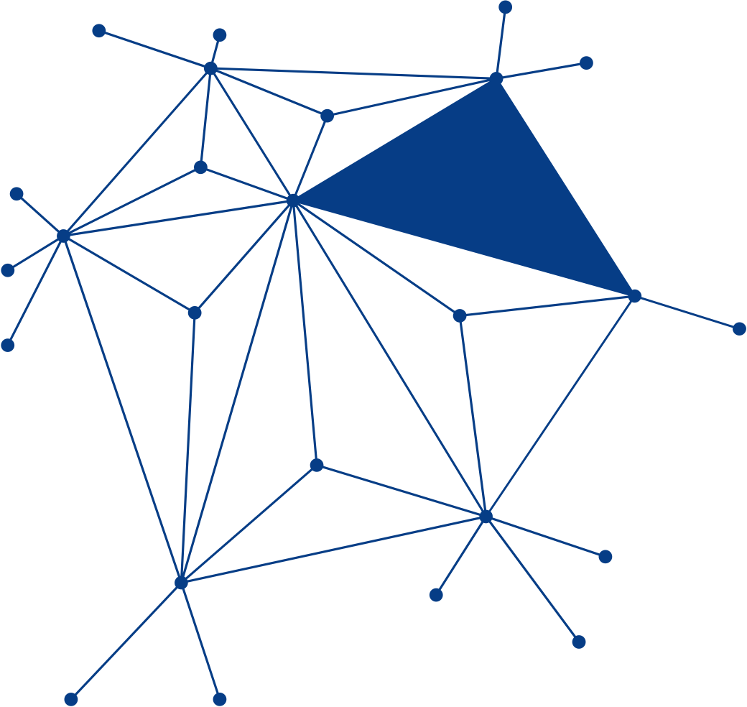
Table of Content
Introduction
Types of Software Privacy Issues
Importance
Privacy Laws & Regulations
Legal Consequences of Priavcy Violations
Real-World Cases
Rights of Users
Responsibilities of software developers
Future challenges
Conclusion

Slide 3
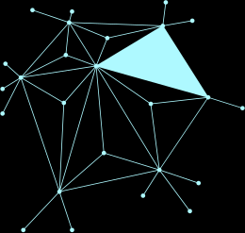

INTRODUCTION
Software privacy refers to the protection of users' personal and sensitive information that is collected, stored, processed, or shared by software applications.
Modern software collects various types of data including personal data, financial data , location data, behavioral data and biometric data.

Slide 4
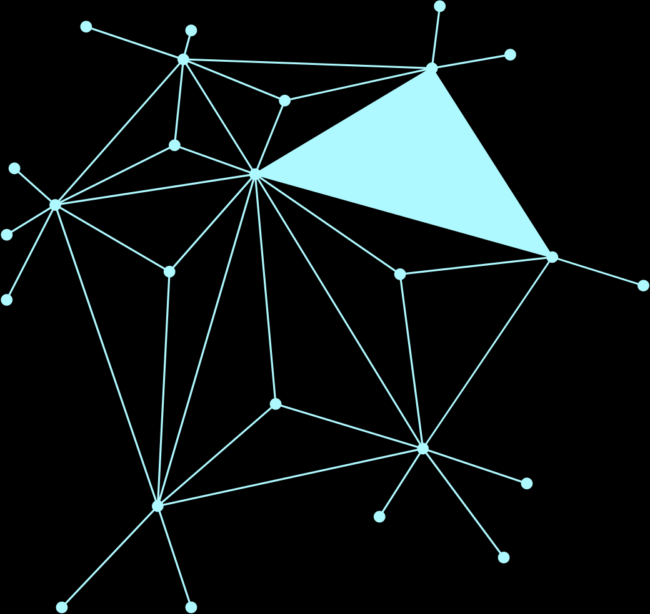
TYPES OF SOFTWARE PRIVACY ISSUES
Data Collection and Tracking: Many applications collect information about users' browsing habits, location, and online activities, often without users fully understanding the extent of the tracking.
Unauthorized Data Sharing: Organizations may share or sell user information to third parties without obtaining clear consent, leading to privacy concerns and loss of trust.
Spyware & Stalkerware: These are malicious programs designed to secretly monitor a user's activities, collect personal information, and track behavior without permission.
Excessive App Permissions: Many mobile applications request access to sensitive features such as cameras, microphones, contacts, and location services, even when such access is not necessary for their functionality.

Slide 5
IMPORTANCE OF SOFTWARE PRIVACY
Software privacy is important because it:
Protects users from identity theft and fraud.
Builds trust between users and organizations.
Ensures compliance with legal requirements.
Prevents misuse of personal information.
Preserves individual rights and freedoms.

Slide 6
PRIVACY LAWS & REGULATIONS
General Data Protection Regulation (GDPR): Requires organizations to obtain clear user consent and protect personal data.
California Consumer Privacy Act (CCPA): Provides consumers with rights to know, delete, and control the sale of their personal information.
Health Insurance Portability and Accountability Act (HIPAA): Protects sensitive medical and health-related information.
Organizations that violate these laws may face severe penalties.

Slide 7
LEGAL CONSEQUENCES OF PRIAVCY VIOLATIONS
Financial Penalties: Governments may impose large fines on organizations.
Lawsuits: Affected users can seek compensation through legal action.
Reputation Damage: Loss of public trust can lead to reduced customers and revenue.
Regulatory Investigations: Companies may be audited and monitored by government agencies.
Business Disruption: Privacy incidents often require costly recovery and compliance efforts.

Slide 8
REAL-WORLD CASES
Facebook–Cambridge Analytica data scandal: Personal information from millions of users was accessed without proper consent and used for political advertising. The incident raised global concerns about data privacy and resulted in investigations and financial penalties.
Google has been fined repeatedly in Europe for illegal tracking and data collection.
Uber: A major data breach affected millions of users, and the company was criticized for delaying disclosure of the incident. Legal actions and fines followed.

Slide 9
RIGHTS OF USERS
Privacy laws grant users important rights over their own data.
The right to access allows users to request what data a company holds about them.
The right to correction lets users fix inaccurate information.
The right to deletion (also called the "right to be forgotten") allows users to request their data be permanently removed.
Users also have the right to opt out of data selling or targeted advertising. Companies are legally required to be transparent and obtain proper consent before collecting data.

Slide 10

RESPONSIBILITIES OF SOFTWARE DEVELOPERS
Developers play a key role in protecting privacy by:
Implementing secure coding practices.
Using encryption to protect data.
Limiting access to sensitive information.
Regularly testing for vulnerabilities.
Following the principle of "Privacy by Design."
Privacy should be considered throughout the software development lifecycle.

Slide 11

FUTURE CHALLENGES
Artificial Intelligence (AI)
AI systems often require large amounts of personal data for training and decision-making.
Internet of Things (IoT)
Smart devices continuously collect user information.
Facial Recognition
Raises concerns about surveillance and consent.
Cross-Border Data Transfers
Different countries have different privacy laws, making compliance more complex.

Slide 12
CONCLUSION
Software privacy is not just a legal requirement — it is a fundamental human right.
As software becomes more deeply embedded in every part of our lives, the responsibility to protect user data grows stronger.
Developers, companies, and governments must work together to balance technological innovation with ethical data practices.
The legal consequences of ignoring privacy are becoming increasingly severe, and the message is clear: privacy must be a priority, not an afterthought.

Slide 13







Slide 14


